Slide 1
Restaurant Management System

Slide 2
Restaurant Management System
Submitted By:
Nazmul Karim Nipun
Sarif Khan Shuvo
Ershad Ullah Khan
Tanvir
Submitted To:
Raza Ahmad Khan
Corporate IT Consultant

Slide 3
1.1 Introduction:
1.2 Technology:
1.2.1: Java Swing
1.2.2: MySQL
1.3 Snapshots of our system:

Slide 4
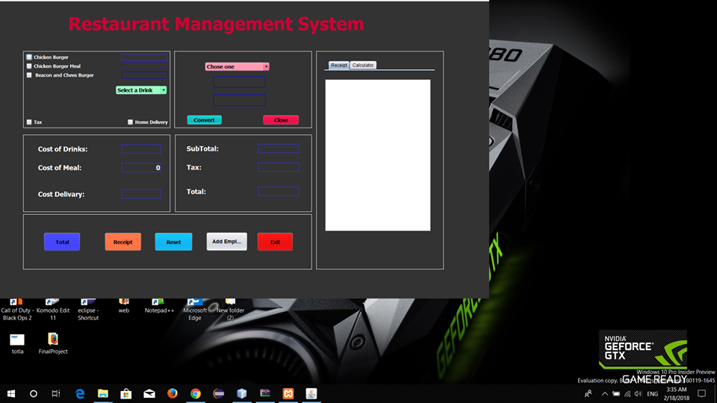
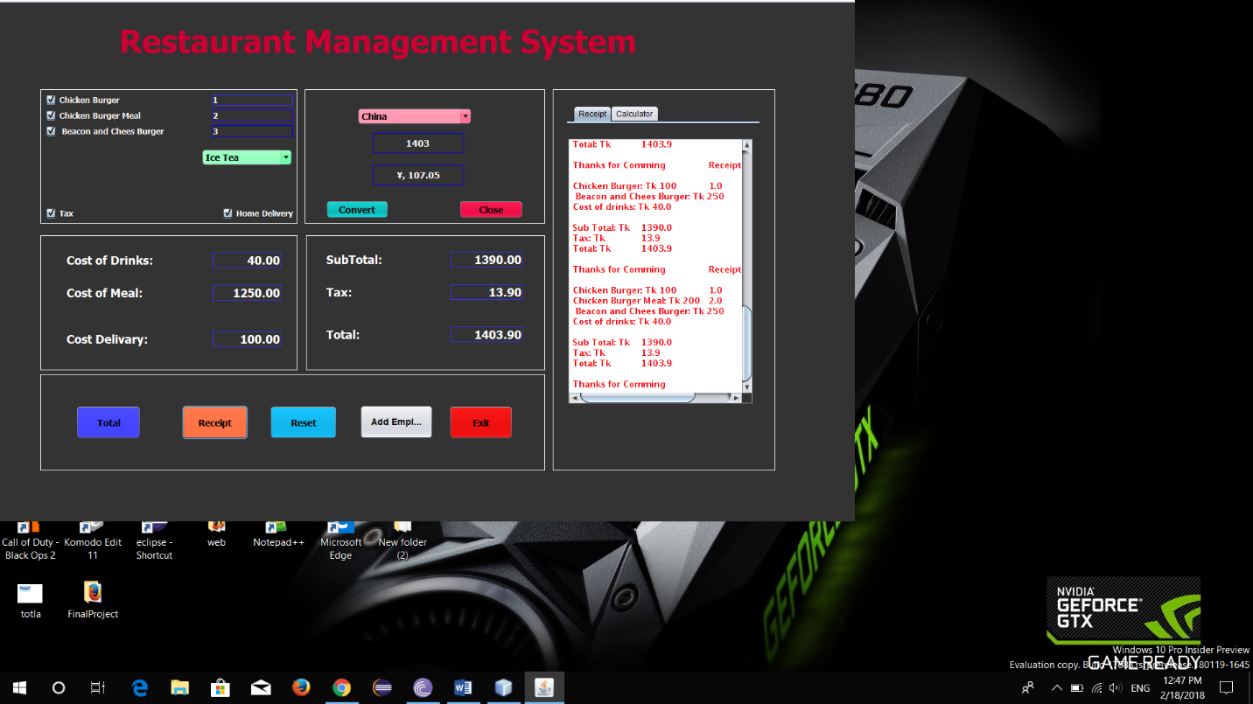
It’s The main Interface of our System:

Slide 5
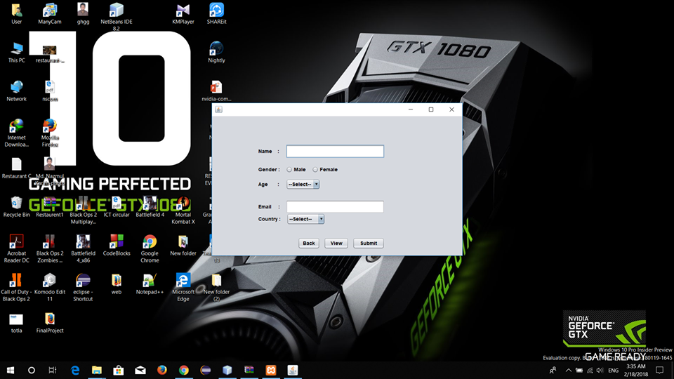
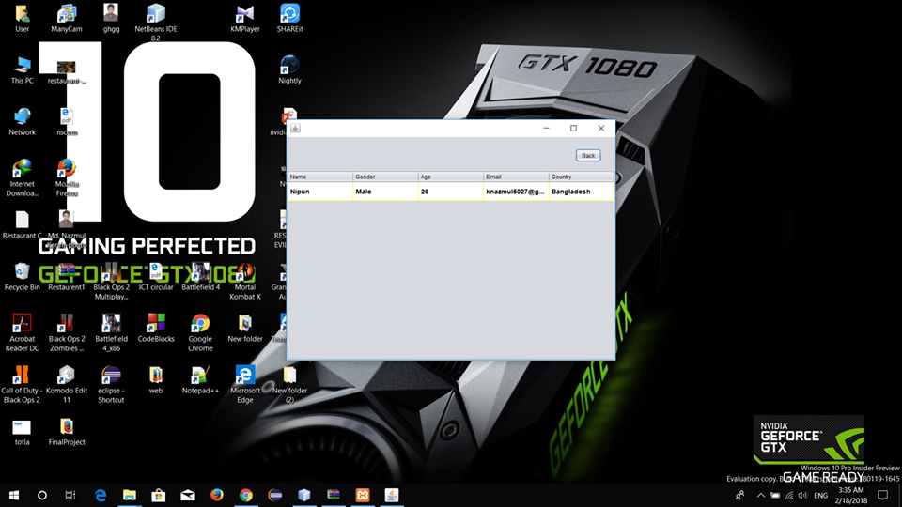
It’s the Registration Interface in our System:

Slide 6
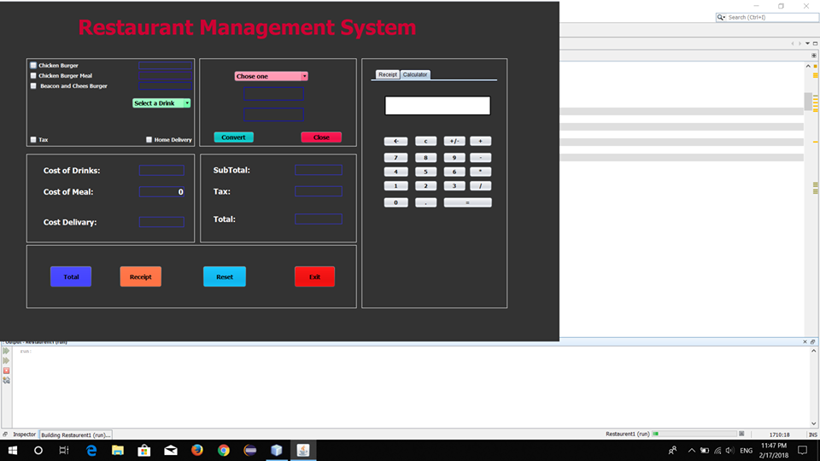
It’s the Different view of our system:

Slide 7
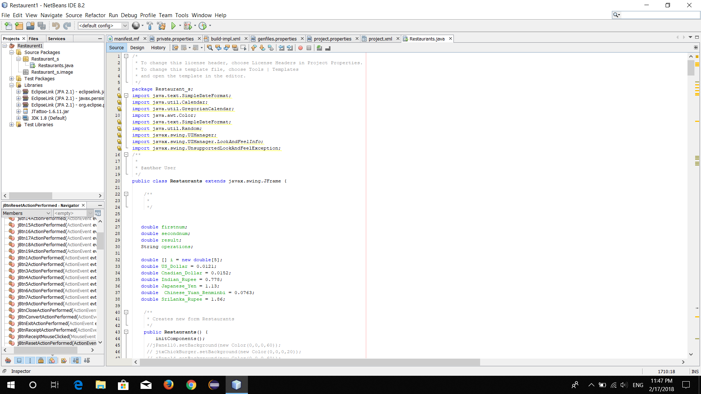
This sections declare all the variables:

Slide 8
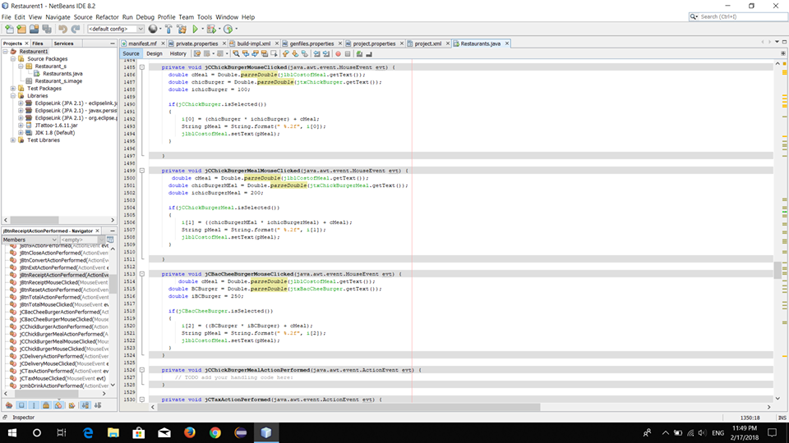
This section is for Checkbox of Meals:

Slide 9
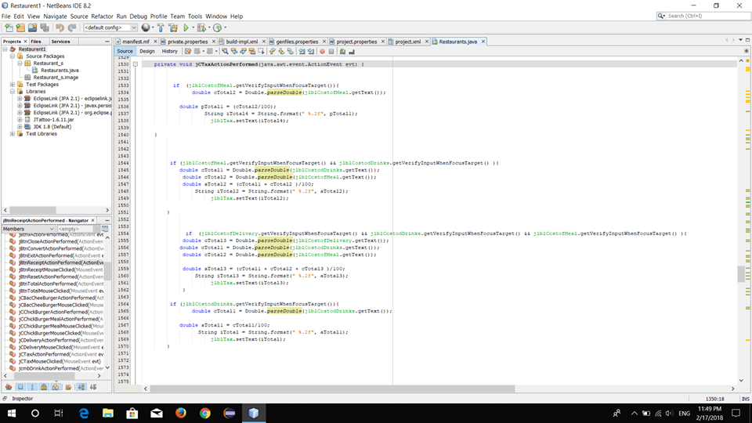
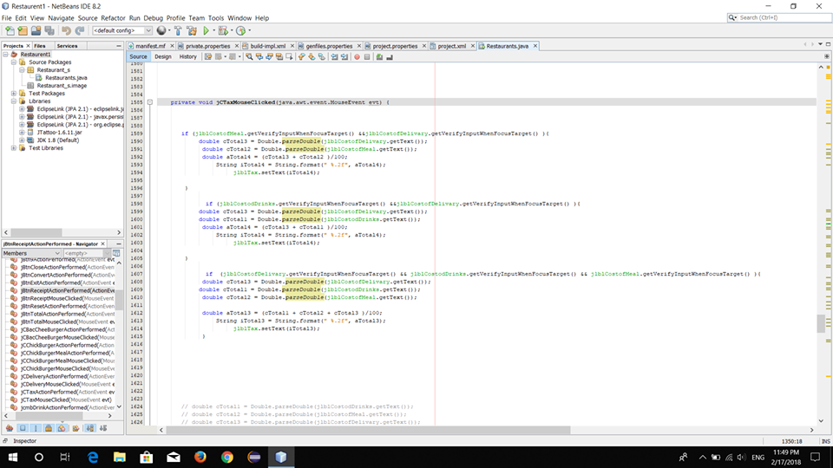
This sections generates the functionality of TAX

Slide 10
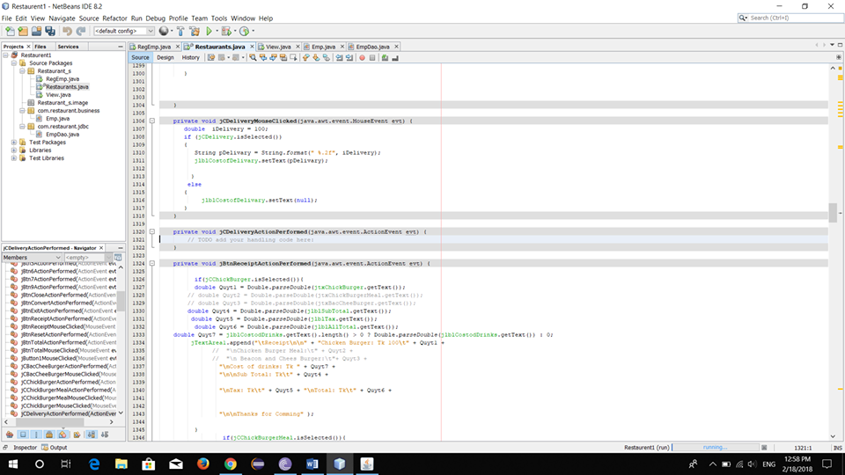
This section provides the Home Delivery function:

Slide 11
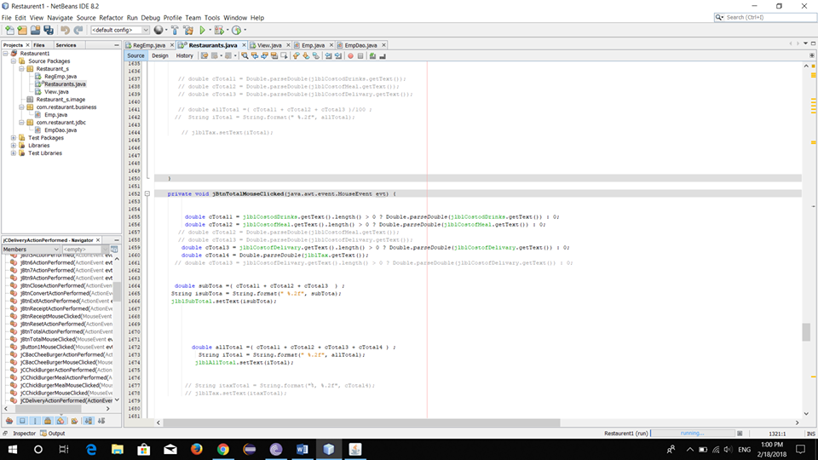
This section provides total Calculation functionality:

Slide 12
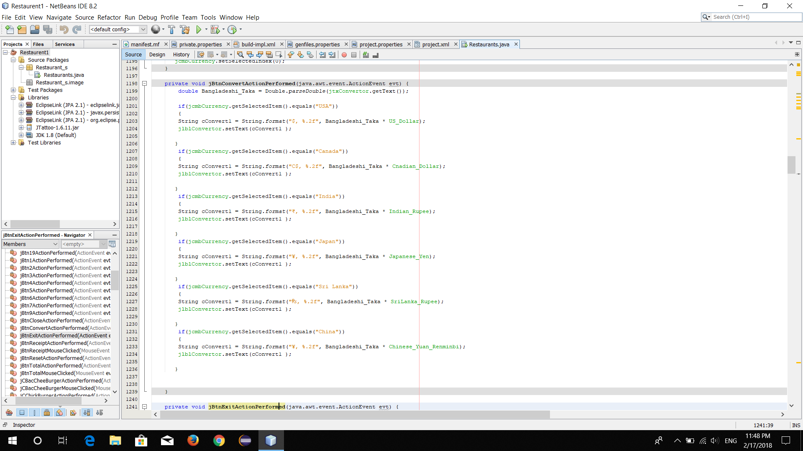
This section provides the functionality of Currency Conversion:

Slide 13
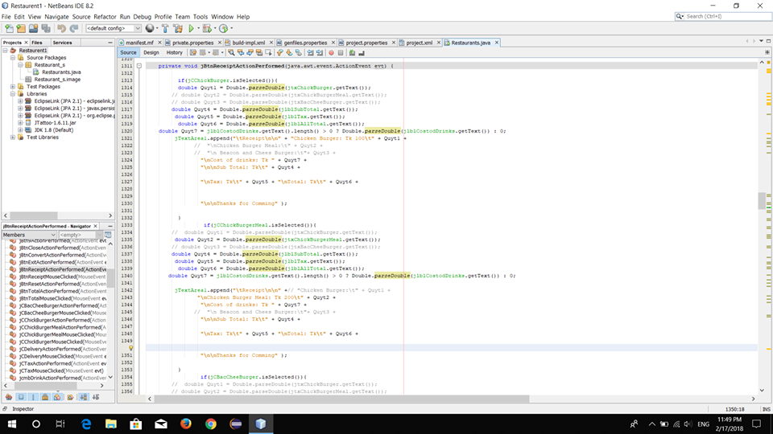
This section provides the functionality of Money Reception:

Slide 14
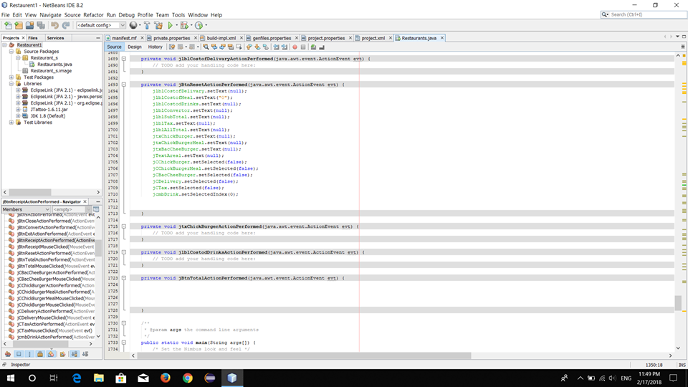
This portion provides the reset functionality:

Slide 15
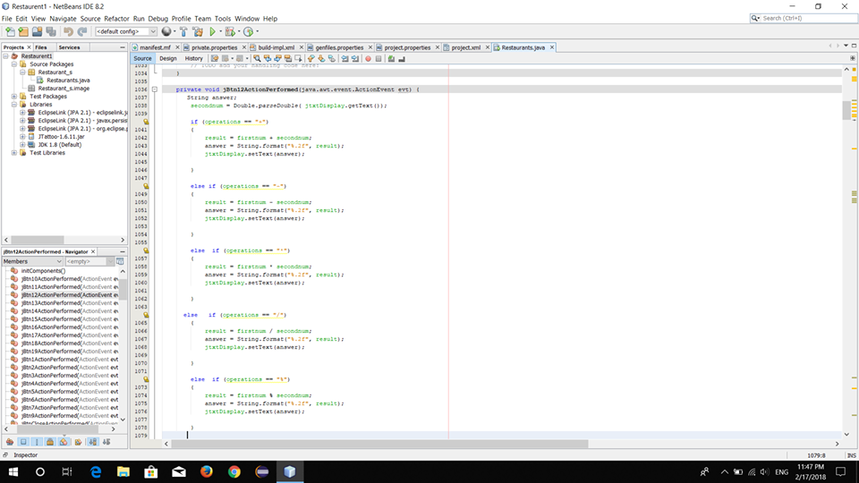
This section provides the functionality of Calculator:

Slide 16
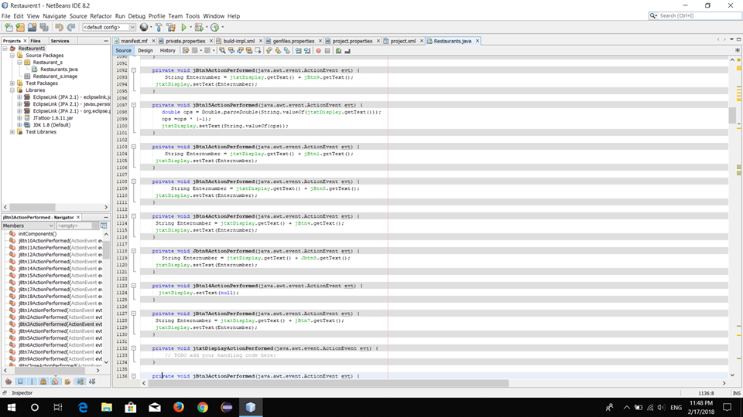
This section provides the functionality of Calculator(cont.):

Slide 17
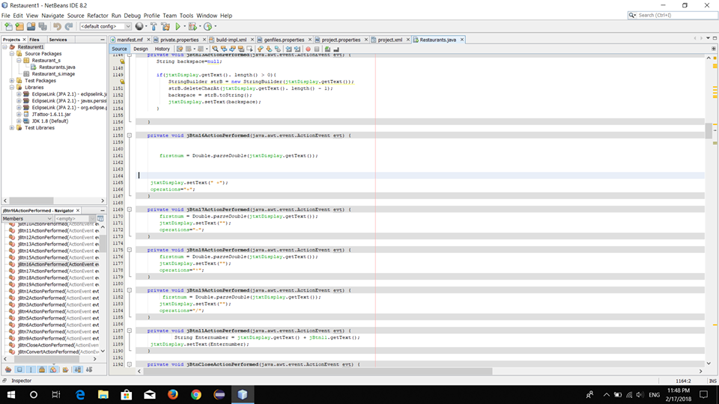
This section provides the functionality of Calculator(cont.):

Slide 18
This section provides the functionality of Calculator(cont.):

Slide 19
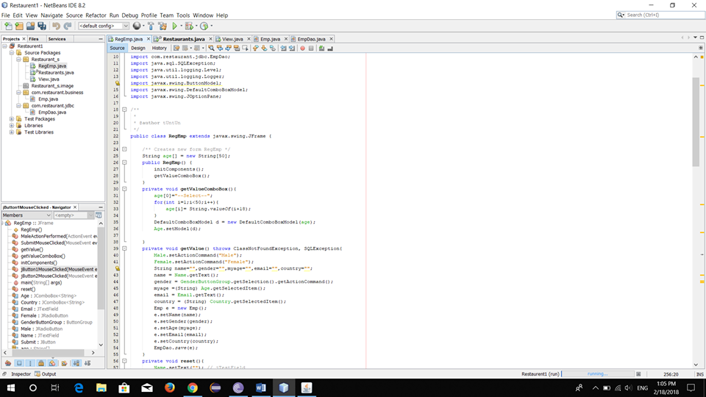
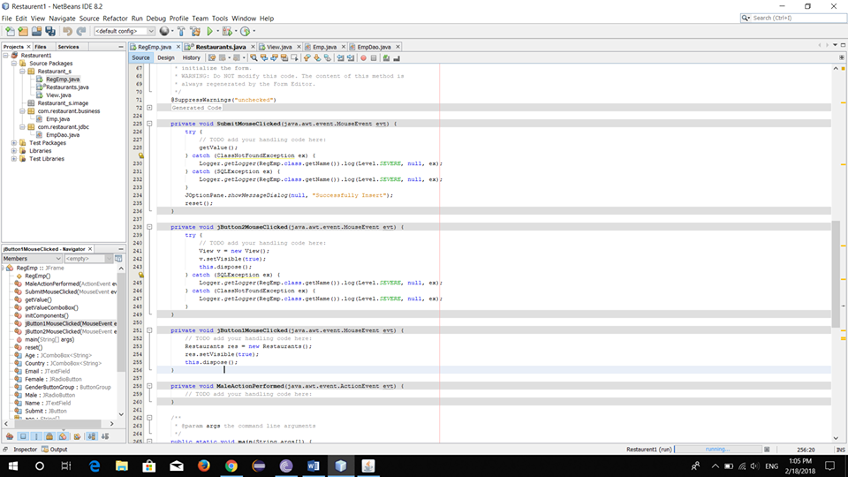
This section provides the functionality of Login:

Slide 20
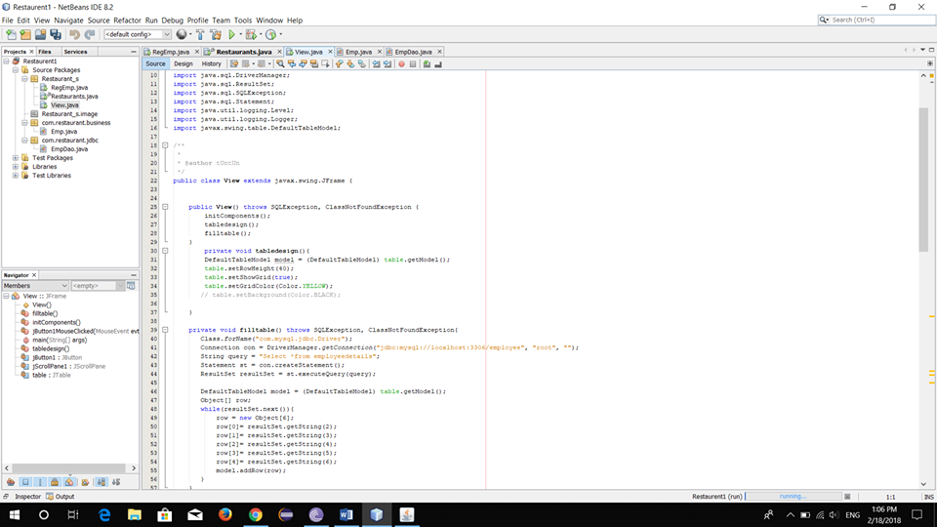
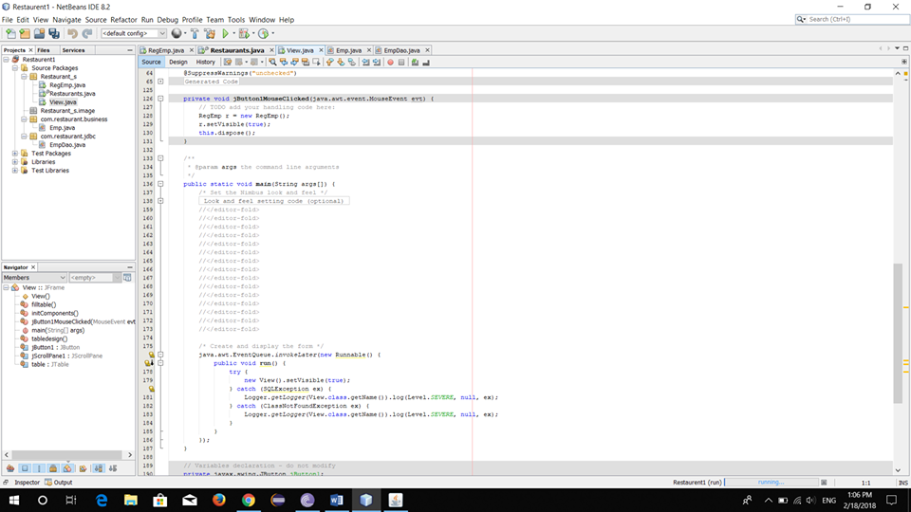
This section provides the functionality of View Submission:

Slide 21
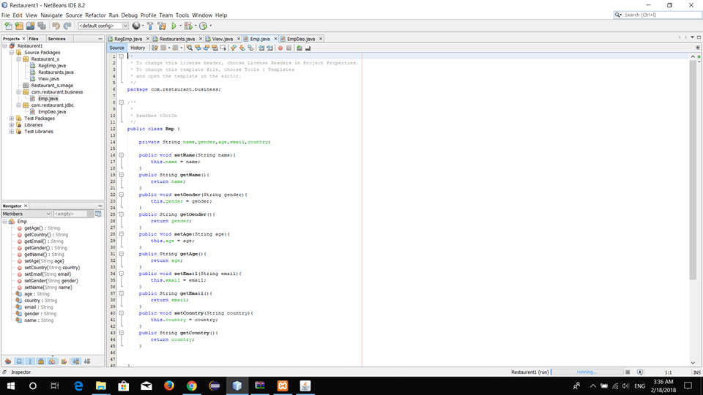
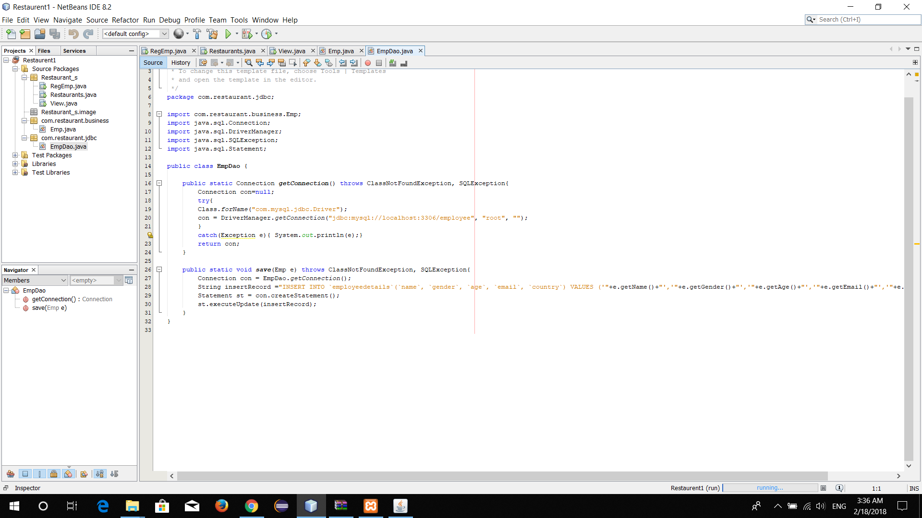
This section provides the functionality Registration and MySQL:

Slide 22
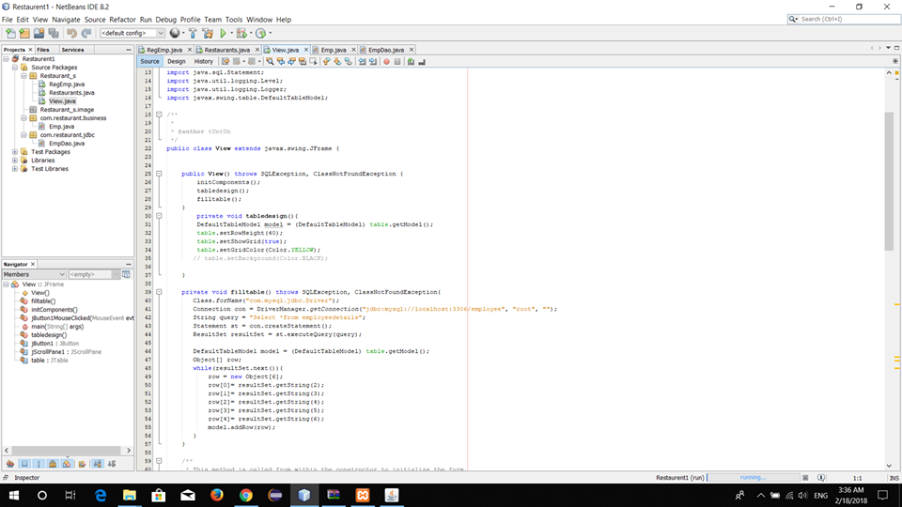
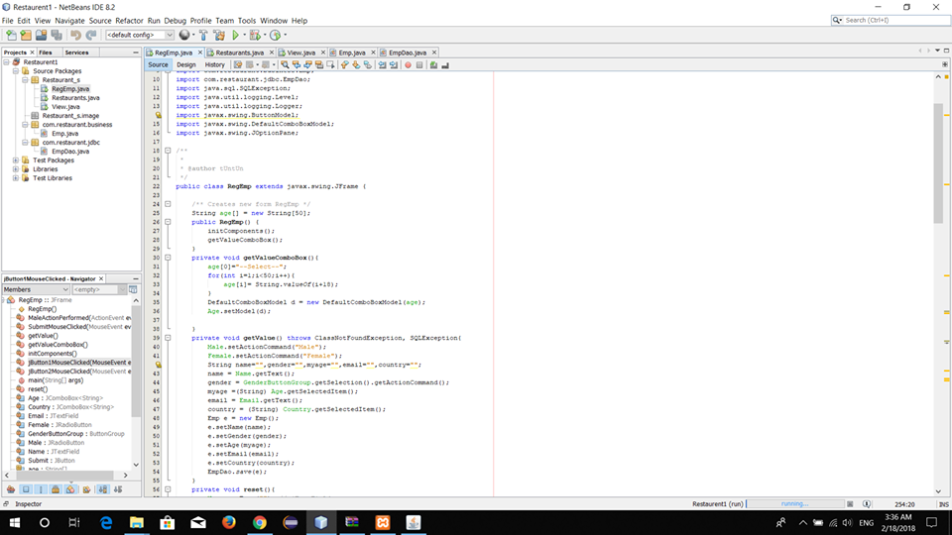
This section provides the functionality Registration and MySQL(cont.):

Slide 23
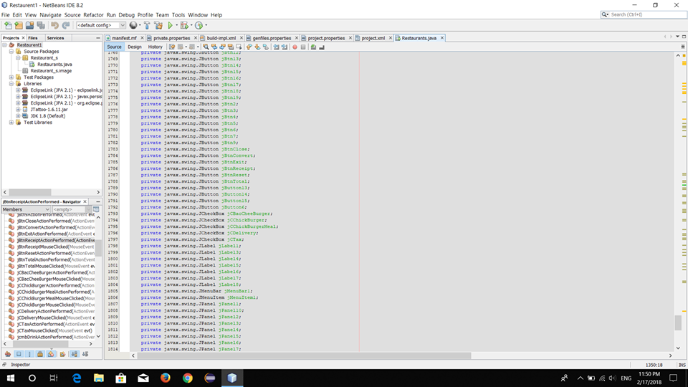
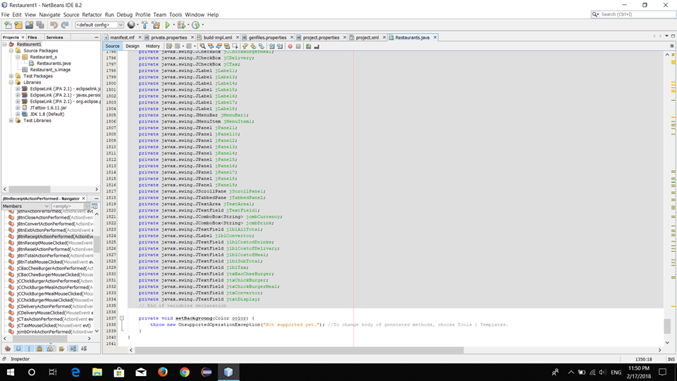
This section provides all the buttons:

Slide 24
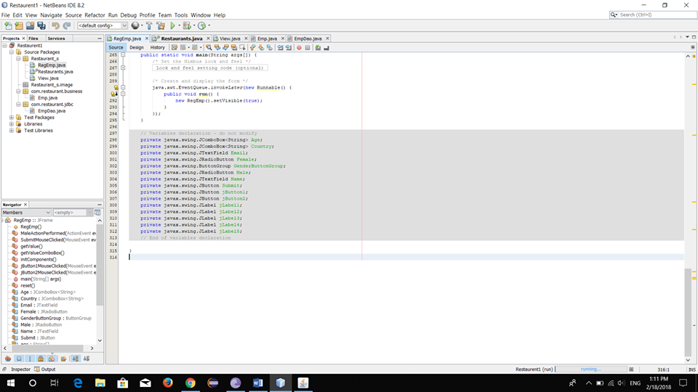
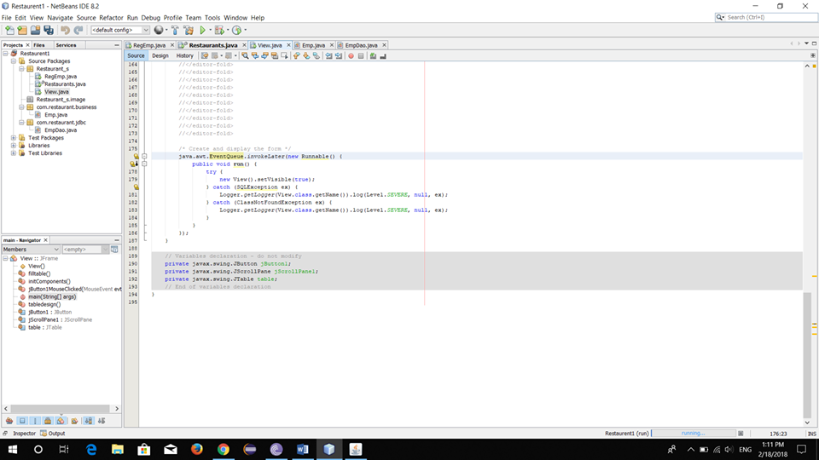
This section provides all the buttons(cont.):

Slide 25
1.4 Limitation of Our System :
1.5 Future Work:
1.6 Conclusion :

Slide 26
Thank you for your Patience.

